Slide 1


타이틀

Slide 2
오브젝트
① ② ③ ④ ⑤ ⑥
4000
2000
2000
2000
2000
1000

Slide 3


타이틀 화면

Slide 4







로비 화면
RANK
11d 03h
NOTICE
1 ??? 11,031,103
2 ??? 11,031,10
V1.0.0 – What’s New?
Blockbuster launched.
3 ??? 11,031,1
CONNECT

Slide 5




인벤토리 화면
back
110303
COMMON PISTOL (+24)
v
DMG +411 (235+75%)
SPEED +135 (77+75%)
Shoot a bullet (250% DMG)
Shoot a big bullet (1000% DMG)
making
character
item
reinforce
Upgrade

Slide 6
설정 화면
back
FULL SCREEN WINDOW
Resolution ◀ 1920 x 1080 ▶
Quality low middle high
Mouse sensitivity
SNS Connection release
Key setting

Slide 7
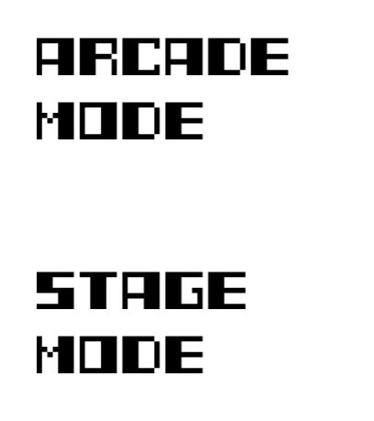


게임 모드 선택 화면
Mode select
back
11d 03h
In Arcade mode,
You can play endlessly and compete Your score with Your sns friends.
In stage mode,
You can play on one
Stage and earn some
Piece, fragments.

Slide 8



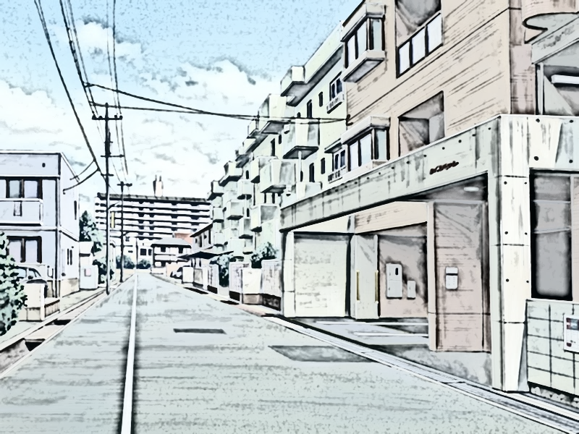




스테이지 선택 화면
stage select
back
11d 03h
Cracked
sky
Event
horizon
Dimension
boundary
Dimension-2

Slide 9

아이템 장착 화면
Equip
back
110303
weapon
character
v
v
info
INventory
Play!

Slide 10

게임 플레이 화면
3200 / 3200 HP

Slide 11
게임 결과 화면
3200 / 3200 HP
SCORE 110311
Piece 919
Item -
Playtime 11:03
Retry
Return to menu

